Slide 1
5COSC019W – Object Oriented Programming Week 7
Dr. Barbara Villarini
b.villarini@westminster.ac.uk

Slide 2
Elements of GUI Programming
Components
Visual objects that appear on the screen
Layouts
Control over the positioning of components within a container
Events
Responses to user actions

Slide 3
Implementing GUI in Java
Two categories of Java Component classes:
AWT – Abstract Windows Toolkit (java.awt package)
The older version of the components
Rely on “peer architecture”…drawing done by the OS platform on which the application/applet is running
Considered to be “heavy-weight”
Swing (javax.swing package)
Newer version of the components
No “peer architecture”…components draw themselves
Most are considered to be “lightweight”

Slide 4
Implementing GUI in Java : Java FX
JavaFX is a software platform for creating and delivering desktop applications, as well as rich internet applications (RIAs) that can run across a wide variety of devices.
It includes all these features in a single library: Media, UI controls, Web, 2D and 3D, etc.. In addition, the developers can also access the existing features of a Java library such as Swings.

Slide 5
Container Class GUI Class Hierarchy (Swing)

Slide 6
AWT vs. Swing
Swing does not replace the AWT; it is built on top of it
All the AWT components are heavyweight: the corresponding Swing components are lightweights
Swing component names begin with “J”:
Component (AWT) – JComponent (Swing)
Button (AWT) – JButton (Swing)
Always use Swing components: however, since Swing is built on top of AWT, you will need to know some AWT methods

Slide 7
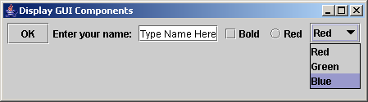
Creating GUI Objects
// Create a button with text OK
JButton jbtOK = new JButton("OK");
// Create a label with text "Enter your name: "
JLabel jlblName = new JLabel("Enter your name: ");
// Create a text field with text "Type Name Here"
JTextField jtfName = new JTextField("Type Name Here");
// Create a check box with text bold
JCheckBox jchkBold = new JCheckBox("Bold");
// Create a radio button with text red
JRadioButton jrbRed = new JRadioButton("Red");
// Create a combo box with choices red, green, and blue
JComboBox jcboColor = new JComboBox(new String[]{"Red",
"Green", "Blue"});
Check Box
Radio Button
Label
Text field
Button
Combo Box

Slide 8
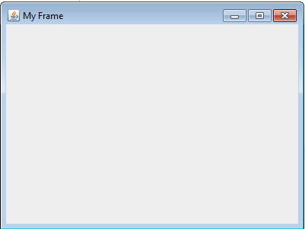
Frames
Frame is a window that is not contained inside another window.
Frame is the basis to contain other user interface components in Java graphical applications.
The Frame class can be used to create windows.

Slide 9
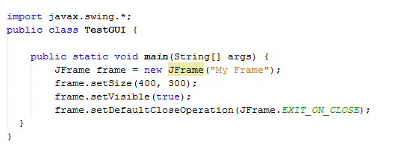
MyFrame
Any use of Swing classes requires importing javax.swing package.
Instantiate a swing Frame object
Set Width and height of the frame in pixels
Call JFrame methods to control visuals and behavior
When user closes the window, the application will terminate
This is needed to make the frame actually show up on the screen

Slide 10
MyFrame
This is what a frame looks like.
Note the title bar, the content area, the minimize, maximize/restore, and close icons.
Caption in the title bar was determined from the argument to the constructor.

Slide 11
Frames with Components
A Frame is a container. Therefore it can contain other components (like buttons, text fields, etc.)
Components are added to the content pane of a frame.
The content pane is the grey area in the Frame window.
A simplistic way to look at containment is this:
A JFrame contains:
A menu bar
A content pane
Title bar
Content Pane

Slide 12
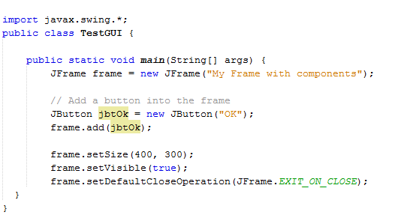
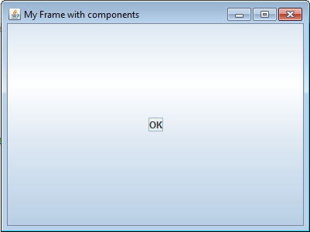
Adding component into a Frame
Button

Slide 13
Adding component into a Frame
Declare a reference variable for a button object.
Instantiate a button

Slide 14
Adding component into a Frame
Add the button to the content pane of the frame.

Slide 15
Layout Managers
The UI components are placed in containers. Each container has a layout manager to arrange the UI components within the container.
Advantage: resizing the container (frame) will not occlude or distort the view of the components.
Main layout managers:
FlowLayout, GridLayout, BorderLayout, CardLayout, and GridBagLayout

Slide 16
Layout Manager Hierarchy
LayoutManager is an interface. All the layout classes implement this interface

Slide 17
FlowLayout
Places components sequentially (left-to-right) in the order they were added
Components will wrap around if the width of the container is not wide enough to hold them all in a row.
Default for applets and panels, but not for frames
Options:
left, center (this is the default), or right
Typical syntax: in your Frame class’s constructor
setLayout(new FlowLayout(FlowLayout.LEFT))
OR
setLayout(new FlowLayout(FlowLayout.LEFT,hgap,vgap))

Slide 18
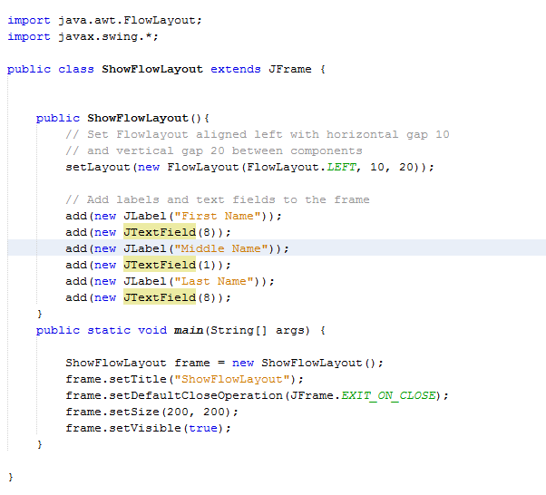
Example – FlowLayout
Creating a subclass of JFrame

Slide 19
Example – FlowLayout
It’s common to make the Frame an application class by including a main method. The main method will instantiate its own class.

Slide 20
Example – FlowLayout
The constructor will typically do the following:
Set the layout manager for the frame’s content pane
Add the components to the frame’s content pane
In this case, the layout is Flow, and 6 Swing components are added

Slide 21
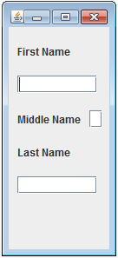
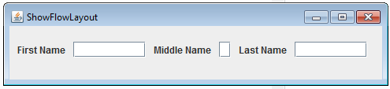

What we get
Resizing the frame causes the components to wrap around when necessary.

Slide 22
GridLayout
Arranges components into rows and columns
In Frame’s constructor:
setLayout(new GridLayout(rows,columns))
setLayout(new GridLayout(rows,columns,hgap,vgap))
Components will be added in order, left to right, row by row
Components will be equal in size
As container is resized, components will resize accordingly, and remain in same grid arrangement

Slide 23
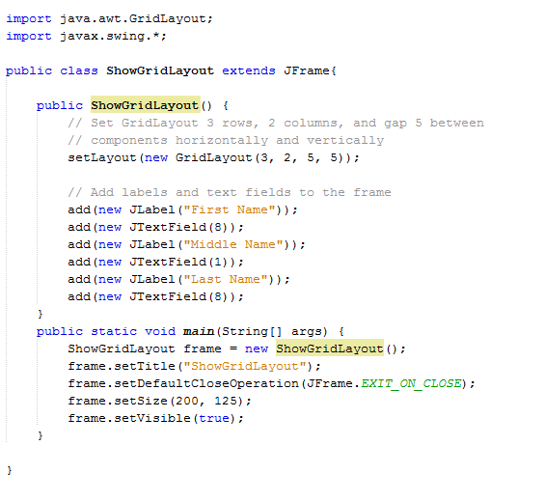
Example - GridLayout
Setting the layout manager
Adding components

Slide 24
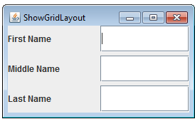
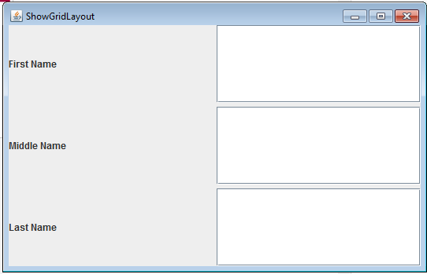
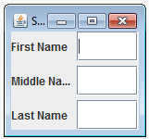
What we get
Resizing the frame causes the components to resize and maintain their same grid pattern.

Slide 25
BorderLayout
Arranges components into five areas: North, South, East, West, and Center
In the constructor:
setLayout(new BorderLayout())
setLayout(new BorderLayout(hgap,vgap))
for each component:
add (the_component, region)
do for each area desired:
BorderLayout.EAST, BorderLayout.SOUTH, BorderLayout.WEST, BorderLayout.NORTH, BorderLayout.CENTER
Behavior: when the container is resized, the components will be resized but remain in the same locations.
NOTE: only a maximum of five components can be added and seen in this case, one to each region.

Slide 26
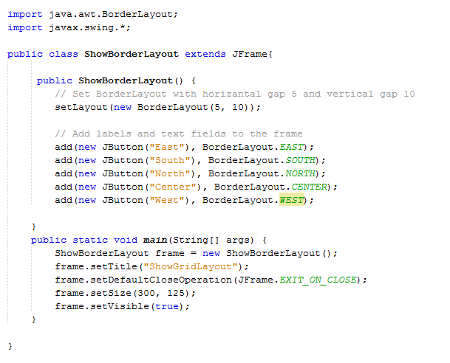
Example - BorderLayout
Setting the layout manager
Adding components

Slide 27
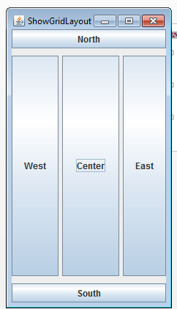
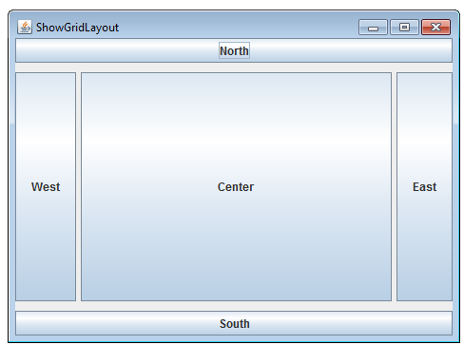
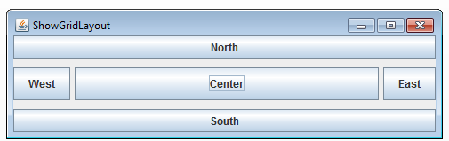
What we get
Resizing the frame causes the components to resize and maintain their same regions.
The CENTER region dominates the sizing.

Slide 28
Using Panels as “Sub-Containers”
JPanel is a class of special components that can contain other components.
As containers, JPanels can have their own layout managers.
This way, you can combine layouts within the same frame by adding panels to the frame and by adding other components to the panels.
Therefore, like JFrames, you can use these methods with JPanels:
add() – to add components to the panel
setLayout() – to associate a layout manager for the panel

Slide 29
Creating a JPanel
You can use new JPanel() to create a panel with a default FlowLayout manager or new JPanel(LayoutManager) to create a panel with the specified layout manager.
Use the add(Component) method to add a component to the panel. For example,
JPanel p = new JPanel();
p.add(new JButton("OK"));

Slide 30
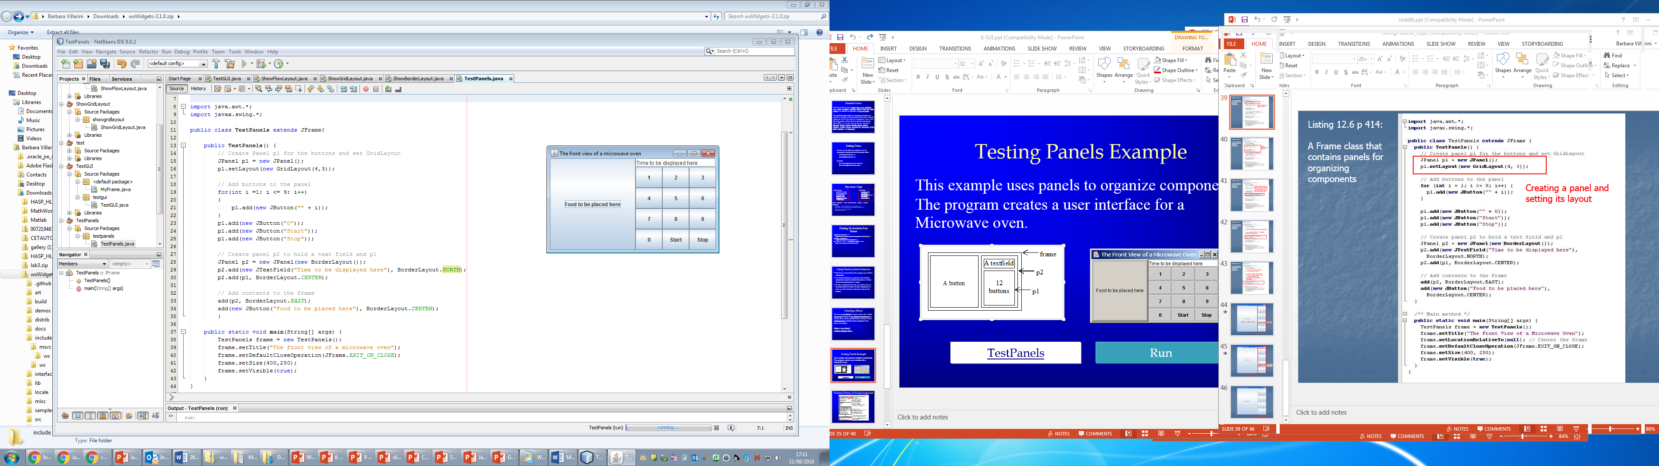
Panels Example
This example uses panels to organize components. The program creates a user interface for a Microwave oven.

Slide 31
Code

Slide 32
The Color Class
You can set colors for GUI components by using the java.awt.Color class.
Colors are made of red, green, and blue components, each of which is represented by a byte value that describes its intensity, ranging from 0 (darkest shade) to 255 (lightest shade). This is known as the RGB model.
Color c = new Color(r, g, b);
r, g, and b specify a color by its red, green, and blue components.
Example: Color c = new Color(228, 100, 255);
Thirteen standard colors (black, blue, cyan, darkGray, gray, green, lightGray, magenta, orange, pink, red, white, yellow) are defined as constants in java.awt.Color.

Slide 33
Setting Colors
You can use the following methods to set the component’s background and foreground colors:
setBackground(Color c)
setForeground(Color c)
Example:
jbt.setBackground(Color.yellow);
jbt.setForeground(Color.red);

Slide 34
The Font Class
Font Names
Standard font names that are supported in all platforms are: SansSerif, Serif, Monospaced, Dialog, or DialogInput.
Font Style:
Font.PLAIN (0), Font.BOLD (1), Font.ITALIC (2), and Font.BOLD + Font.ITALIC (3)
Font myFont = new Font(name, style, size);
Example:
Font myFont1 = new Font("SansSerif ", Font.BOLD, 16);
Font myFont2 = new Font("Serif", Font.BOLD+Font.ITALIC, 12);
JButton jbtOK = new JButton("OK“);
jbtOK.setFont(myFont1);

Slide 35
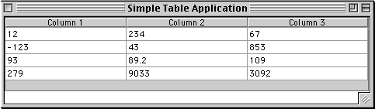
JTable
Displays a grid of data consisting of rows and columns similar to a spreadsheet
Does not contain or cache data but it is a simple view of the data
Header contain column labels
Cell containing data item
Column displays a type of data

Slide 36
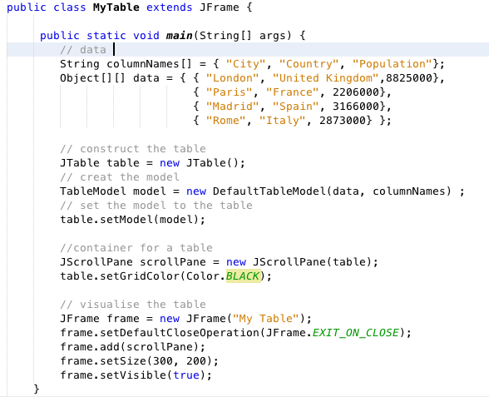
Create a simple table
Header contain column labels
Data to display
Create JTable component
Create the model that holds the data
Link the model to the table
Add the table in a container

Slide 37


Model/View/Controller
Swing architecture is rooted in the model-view-controller (MVC) design
MVC architecture calls for a visual application to be broken up into three separate parts:
A model that represents the data for the application
The view that is the visual representation of that data
A controller that takes user input on the view and translates that to changes in the model.”
Data display
refresh
View
Controller
User input
UI:
events
refresh
manipulate
Data model
Data:
Model

Slide 38
Table Model
Each JTable has a TableModel object that holds the data shown by the table.
DefaultTableModel is a default implementation of TableModel
By default it makes all the cells editable
We can customize its behavior by subclassing
Or we can implement TableModel from scratch creating a class that extends AbstractTableModel
ADVANTAGES:
Data synchronisation easier: Suppose you have an ArrayList of some Java objects. You have to convert this data into Object[][] to populate the JTable. If you make changes to the JTable, you have to remember to make corresponding changes in the ArrayList of the underlying data

Slide 39
Create your own Table Model
You need to override the following abstract methods:
public int getRowCount();
public int getColumnCount();
public Object getValueAt(int row, int column);
public class BookTableModel extends AbstractTableModel {
private String[] columnNames = {"Title","Author","Price"};
private ArrayList<Book> myList;
public BookTableModel(ArrayList<Book> bkList) {
myList = bkList;
}
public int getColumnCount() {
return columnNames.length;
}
public int getRowCount() {
return myList.size();
}
Suppose we have Book objects, where the instance variables are Title, Author and Price.
Constructor
Continue in the next slide ->

Slide 40
…continue
public Object getValueAt(int row, int col) {
Object temp = null;
if (col == 0) {
temp = myList.get(row).getTitle();
}
else if (col == 1) {
temp = myList.get(row).getAuthor();
}
else if (col == 2) {
temp = new Double(myList.get(row).getPrice());
}
return temp;
}
// needed to show column names in JTable
public String getColumnName(int col) {
return columnNames[col];
}
public Class getColumnClass(int col) {
if (col == 2) {
return Double.class;
}
else {
return String.class;
}
}
}

Slide 41
Using your own model:
….
ArrayList<Book> myList = new ArrayList<Book>();
// ... Here some code to fill the arrey list with Book objects
BookTableModel tableModel = new BookTableModel(myList);
Jtable table = new JTable(tableModel);
// add to the container and continue the code
JScrollPane scrollPane = new JScrollPane(table);
...

Slide 42
Event Handling

Slide 43
What is an Event
GUI components communicate with the rest of the applications through events.
An event is an object that describes a state changes in a source
An event occurs every time the user
Types a character or
Pushes a mouse button
The source of an event is the component that causes that event to occur.
The listener of an event is an object that receives the event and processes it appropriately.
That object must:
Implement the appropriate interface
Be registered as an event listener on the appropriate event source.

Slide 44
Event Handling
GUIs are event-driven
A user interaction creates an event
Common events are clicking a button, typing in a text field, selecting an item from a menu, closing and window and moving the mouse
The event causes a call to a method called an event handler
Class java.awt.AWTEvent

Slide 45
Delegation Event Handling Model
Three parts
Event source
GUI component which user interacts with
Event object
Encapsulates information about event that occurred
Event listener
Receives event object when notified, then responds
Programmer must perform two tasks
Register event listener for event source
Implement event-handling method (event handler)

Slide 46
What is an Event Listener?
An event listener is an object
It "listens" for events from a specific GUI component (itself an object)
When an event is generated by the GUI component a method in the listener object is invoked to respond to the event

Slide 47

What if there is no event listener?
When there is no event listener for an event
A program can ignore events
If there is no listener for an event, the event is just ignored

Slide 48
Recap the Event Handling process
Event Source
1
Source
registers
Listener
2
Fires an
Event Object
Event Listener
Reacts to the
Event
3

Slide 49
What do we need to implement an Event Handler?
It just looks for 3 pieces of code!
First: Implement an event handler Class. In the declaration of the class, one line of code must specify that the class implements either a listener interface or extends a class that implements a listener interface.
public class DemoEventHandlerClass implements ActionListener {

Slide 50
What do we need to implement an Event Handler?
Second: Register the listener to the component. There will be a line of code which registers an instance of the event handler class as a listener of one or more components because, as mentioned earlier, the object must be registered as an event listener.
anyComponent.addActionListener(instance of DemoEventHandlerClass);

Slide 51
What do we need to implement an Event Handler?
Third: the event handler must have a piece of code that implements the methods in the listener interface.
public void actionPerformed(ActionEvent e) {
...//code that reacts to the action...
}

Slide 52
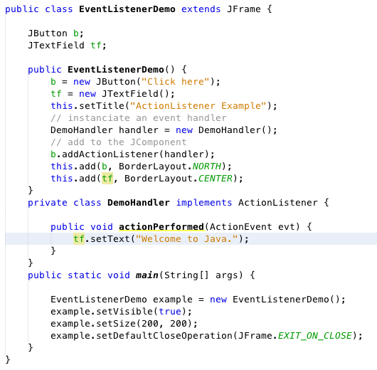
Example

Slide 53
References
http://java.sun.com/docs/books/tutorial/uiswing/events/index.html
http://java.sun.com/docs/books/tutorial/uiswing/learn/example2.html#handlingEvents

